Slide 1
Welcome to HIST 1120!
Dr. Tracy Penny Light
Week 7

Slide 2
Today's Overview
The Struggle for Empire
Assessing the Impact of the Conquest
Adjusting to British Rule

Slide 3
The Struggle for Empire
THE ACADIAN EXPULSION
THE FALL OF NEW FRANCE
THE SEVEN YEARS’ WAR
THE STRUGGLE FOR EMPIRE - ON NORTH AMERICAN SOIL
BATTLE OF THE PLAINS OF ABRAHAM
SURRENDER AND NEGOTIATION
ASSESSING THE IMPACT OF THE CONQUEST

Slide 4
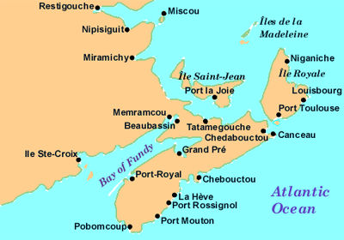
Acadia by 1670s
Notes:
Starting in the 1670s, colonists left Port-Royal to found other centres, the most important being Beaubassin (Amherst, Nova Scotia) and Grand-Pré (now Grand Pre, Nova Scotia). The first official census, held in 1671, registered an Acadian population of more than 400 people, 200 of which lived in Port-Royal. In 1701 there were about 1400; in 1711, some 2500; in 1750, over 10 000; and in 1755, over 13 000 (Louisbourg excluded).

Slide 5
The Great Expulsion (also known as The Deportation, or Le Grand Dérangement)
1754: beginning of war between the French and English in North America
Most Acadians refuse to sign an unconditional oath of allegiance to British Crown
1755: British capture Fort Beauséjour, and discover 300 armed Acadians inside French lines
Lieutenant-governor Charles Lawrence and the Nova Scotia Council decide to deport the Acadians

Slide 6
Seven Years’ War (1756-1763)
War between France and Britain (and their respective allies)
The war in Europe was officially declared in 1756
Informal warfare between the French and English had broken out in the Ohio Valley in 1754, two years before war was formally declared in Europe
The Seven Years War profoundly altered the balance of power in North America: by the end of the war New France had fallen to the British!!
The War also opened the way for a dramatic confrontation between Britain and its thirteen colonies – the American Revolution

Slide 7
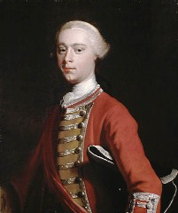
Portrait of General James Wolfe
“I would cheerfully sacrifice a leg or an arm to be in possession of Québec”
Library and Archives Canada

Slide 8
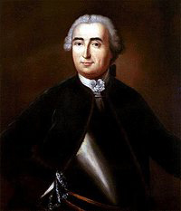
Montcalm on the Plains of Abraham
Source: Ralph Clark Stone
“Oh, when shall we get out of this country! I think I would give half that I have to go home”
Library and Archives Canada
Notes:
Montcalm on the Plains of Abraham by Toronto printer Ralph Clark Stone, after a painting by A.H. Hider. Copyright expired.
Online at Library and Archives Canada.

Slide 9
Battle of the Plains of Abraham (Battle of Québec)
13 September, 1759 – the British attempt (once
again) to capture Québec
Both Wolfe and Montcalm were mortally wounded during the battle
By 18 September, 1759, Québec had fallen to the British
Although the fighting continued for another year, the Battle of the Plains of Abraham was very significant – it turned the tide in favour of the British in the larger struggle for North America

Slide 10
Adjusting to British Rule

Slide 11
Royal Proclamation of 1763
Partly response to Pontiac’s Rebellion (1763-1765)
Issued by King George III on October 7, 1763
Replaced French laws with British laws, and defined the boundaries of Québec
The interior region west of the Allegheny Mountains was declared to be “Indian territory”
Stated that transactions involving Aboriginal land had to be properly negotiated through the British Crown
Contributed to outbreak of the American Revolution

Slide 12
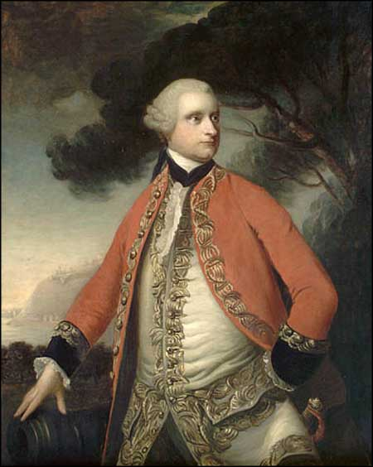
GOVERNOR JAMES MURRAY
-First British (and Civil) Governor of Québec (1764-1766)
-Made many concessions to the French inhabitants of Québec
-British merchants petitioned for his removal - led to his recall in 1766
-His recommendations to retain French civil law and to open government positions to Roman Catholics were eventually adopted in the Québec Act (1774)

Slide 13
Quebec Act, 1774
Guaranteed church taxation
Legal recognition of the seigneurial system
Reintroduced French civil law
Roman Catholics permitted to participate in colonial government
Enlarged the boundaries of Québec

